Slide 1
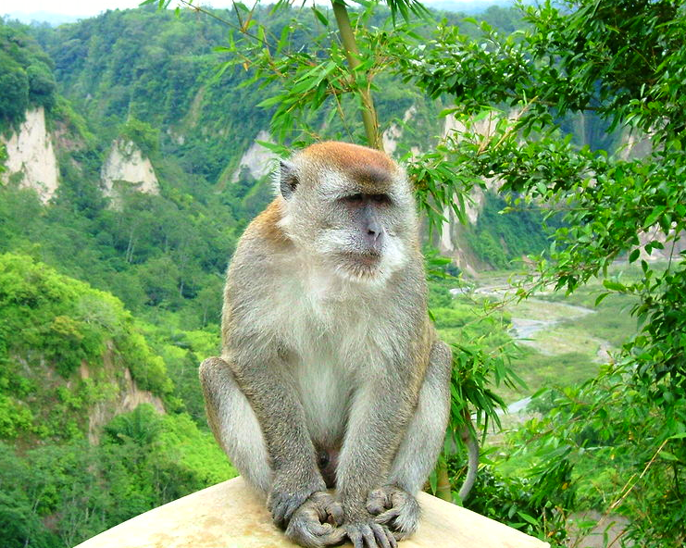
GEO Biodiversity Observation Network Integration and interoperability of biodiversity systems
National Aeronautics and Space Administration
NASA Biodiversity Meeting
Alexandria, VA
6 October 2011
Sakurai Midori, Wikimedia Commons
Gary GELLER
NASA Ecological Forecasting Program
Jet Propulsion Laboratory
California Institute of Technology
(c) 2011 California Institute of Technology. Government sponsorship acknowledged.
Notes:
1
Woody mentioned EOS for Biodiversity…GEO BON would be a major component of that, maybe the central component.

Slide 2
Short History
World Summit on Sustainable Development
2002
2003
2005
2006
GEO formed
GEOSS established
GEO BON first meeting (Geneva)
Notes:
WSSD Johannesburg
GEO original co-chairs Japan, EU, South Africa, USA
GEOSS has 9 SBAs, including Biodiversity
GEO BON co-leads NASA and DIVERSITAS (later, EBONE)

Slide 3
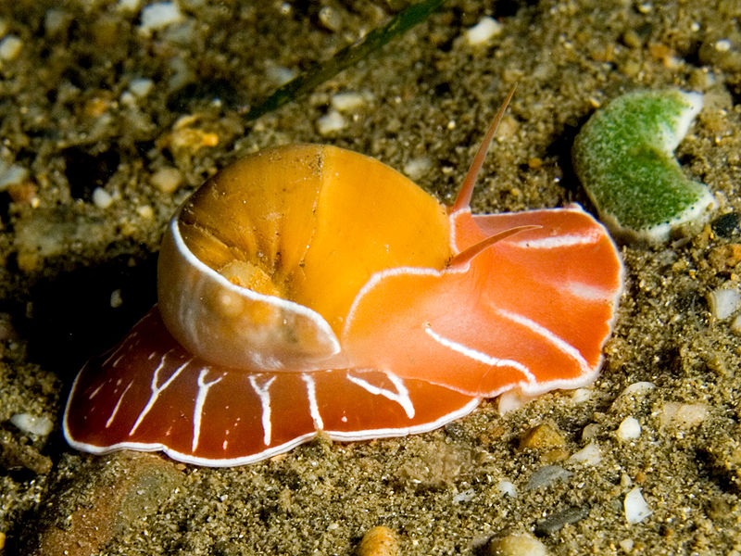
Biodiversity Data
Lots of it…
Many sources and systems
Systems are not connected
Mash ups are difficult
Limited sharing
Global view is impossible
Wikimedia Commons
Notes:
3

Slide 4
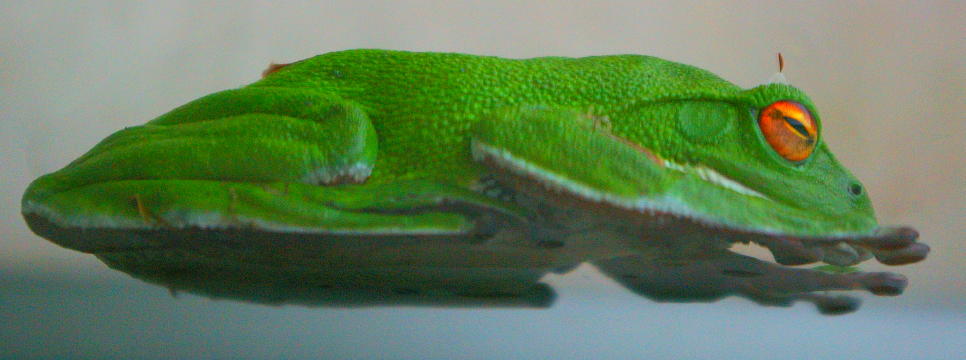
GEO BON
Develop global “network of networks”
Interoperability
Coordinate…
Collection, management, distribution
Facilitate new products and services
Notes:
4
Interoperability…of biodiversity and relevant environmental systems…to increase accessibility and support generation of new cross-system products
Coordinate biodiversity and related data

Slide 5
Basic Questions
How is biodiversity changing?
Why is it changing?
What are the impacts?

Slide 6
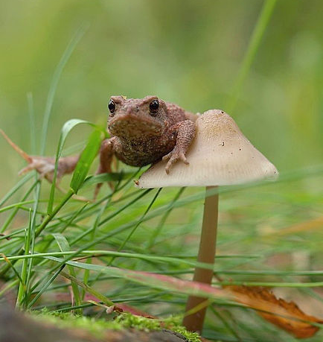
Focal Areas
Ecosystems
Species
Genes
Ecosystem services
Wikimedia Commons

Slide 7
Users
UN Convention on Biological Diversity
Assessment bodies (e.g. IPBES)
Decision makers at all levels
Researchers
General public
Wikimedia
commons
Notes:
Also, probably other UN Conventions

Slide 8
Biodiversity Science-Policy Landscape
Assessment
(IPBES)
Research
Observations
(GEO BON)
Policy
(UNCBD…)
Slide courtesy of Anne Larigauderie/DIVERSITAS

Slide 9
Climate Science-Policy Landscape
Assessment
(IPCC)
Research
Observations
(GCOS, GOOS…)
Policy
(UNFCCC)
Slide courtesy of Anne Larigauderie/DIVERSITAS

Slide 10
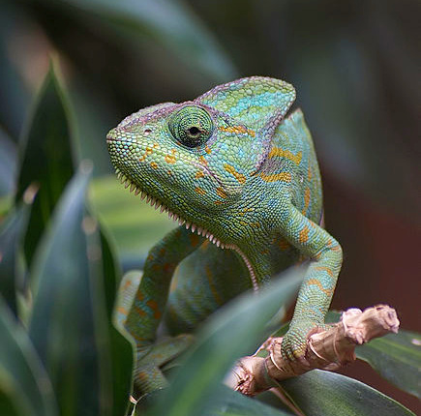
Example GEO BON Products
Change analyses
Trends in ecosystem services
Trends in population size
Trends in ecosystem health or extent
Wikimedia
commons

Slide 11
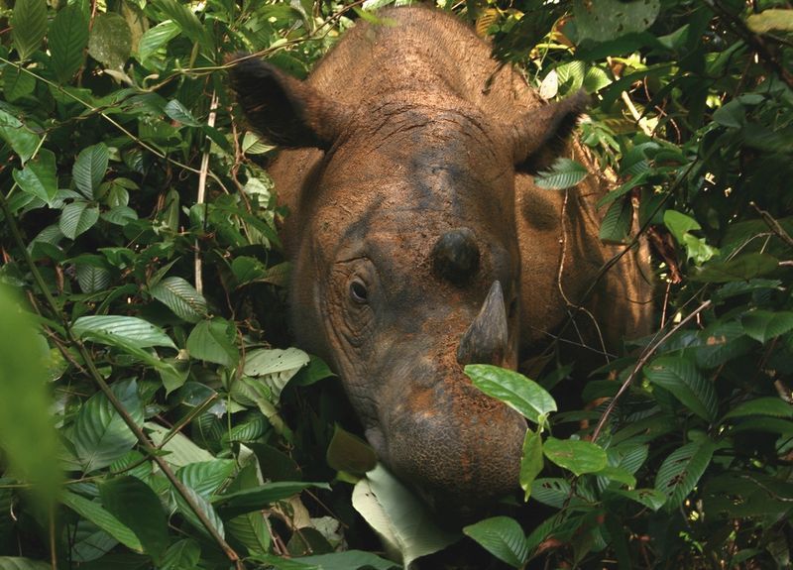
Implementation Approach
Voluntary contributions
Collaborative
Opportunistic
9 Topical working groups
Wikimedia
commons
Notes:
Are there 9 WGs now?

Slide 12
Wageningen Adequacy Report
CBD asked GEO BON to assess adequacy of existing observations relevant to the Aichi targets
Wageningen workshop (52 experts)
Drafted report
Peer-reviewed by 77 others
Notes:
Aichi targets: 4 strategic goals, each with 3-6 targets on topics such as “habitat loss, fragmentation and degradation”, “control of invasive alien species”, and sustainable exploitation of marine resources.

Slide 13
Essential Biodiversity Variables
Inspired by Essential Climate Variables
Critical for understanding the climate system and how it is changing
Support IPCC and UNFCCC
Direct measurements
Calculated variables plus their dependencies
Just starting…
Notes:
ECVs such as precipitation, sea surface temperature, and land cover

Slide 14
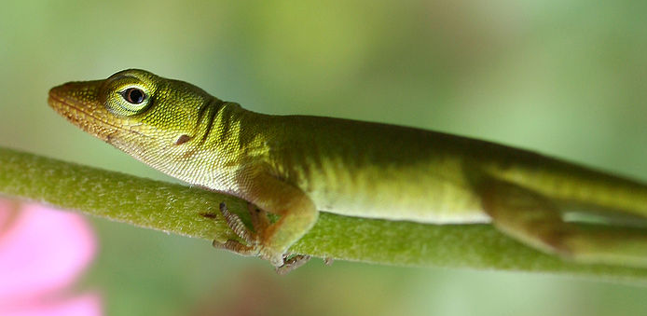
EBVs: Next Steps
Complete list of EBVs
Establish protocol for peer review and updates
Wikimedia
commons

Slide 15
Global Wetland Observing System
Ramsar State of the World’s Wetlands reports
Analogous to IPCC reports
Requires observational input
GWOS
Concept initiated by WG4, + WI
Miniature GEO BON
Wikimedia Commons

Slide 16
GEO BON Next Steps
Develop EBVs and pursue GWOS
Engage national governments
Large coordination meeting in 2012
Develop global indicators
Put in context of an EOS for biodiversity
Wikimedia
commons

